Slide 1


Webmarkup
College 7
[3 EC, 84 SBU , Product]
Location : Haarlem
Micha van der Meer (INF) , Frank Dersjant (IT)
Version 3.02
Notes:
company logo are respective owned by the company
Photo’s used are royalty free and under (CC0) license pixels.com
All other not mentioned graphics or text are © Witan BV
Questions ? Lecture material owner micha van der Meer

Slide 2

Course planning
Term 1 – 19/20 |  | Week
Lecture 1 | Introduction, Webmarkup setup | 36
Lecture 2 | Basic HTML | 37
Lecture 3 | Advanced HTML | 38
Lecture 4 | Basic CSS | 39
Lecture 5 | Advanced CSS | 40
Lecture 6 | Expert CSS + provision and explaining (end)assessment | 41
Lecture 7 | Webmarkup development tools | 42
Exam weeks | Finishing assessment | 44 – 45
10 November 2019 23:59 | Deadline assessment | 45
2

Slide 3
Questions about the previous lectures?
Float
Basic layouts
Resolution
Position [static, absolute, relative and fixed]
Media queries [pc, mobile and tablet]
Z-index
Flexbox
3

Slide 4

Quiz
5 min
HTML 5 / CSS or wrong? | Right | Wrong
I. <div class="alert alert-primary" role="alert">
II. grid-template: 150px / 5% / 3em auto;
III. mix-blend-mode: darken;
IV. overflow-horizonal : hidden;
V. img { position: absolute; left: 0px; top: 0px; z-index: -1; }
4
Notes:
Bootstrap , but div is always wrong :P
CSS grid, but value is a discussion.
CSS
No, overflow-x: hidden;
Yes, img behind text.

Slide 5


Grid
REMEMBER?
GRID
5
Notes:
(CC0) license pixels.com

Slide 6

Grid
flexbox & float ??
6
Notes:
Can we throw everything away?
(CC0) license pixels.com

Slide 7
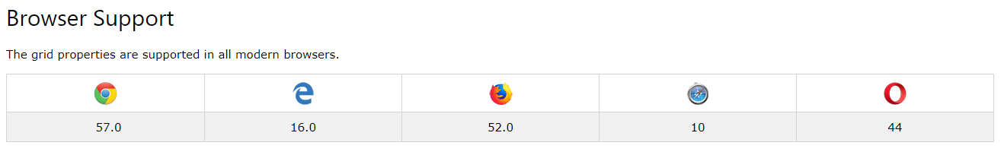
Grid
Grid of support [Oct 2018]
7
Notes:
https://www.w3schools.com/css/css_grid.asp

Slide 8
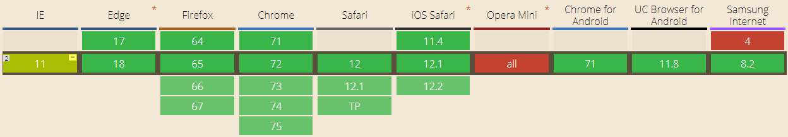
Grid
Calculation from Grid of support for currently selected criteria [March 2019]
8
Notes:
https://caniuse.com/#search=grid

Slide 9
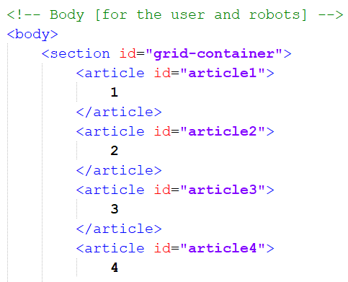
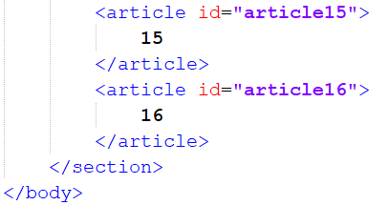
Grid on an applied science way [Setup]
[.html]
*Hack and Slash* Article 4 till 14
9

Slide 10
Grid on an applied science way [Setup]
[.html]
*Hack and Slash* Article 4 till 14
10

Slide 11
Grid on an applied science way [Setup]
[.html]
*Hack and Slash* Article 4 till 14
11

Slide 12
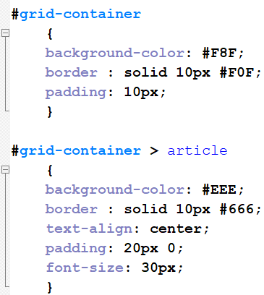
Grid on an applied science way [Setup]
[.html][.css]
*Hack and Slash* Article 4 till 14
12

Slide 13
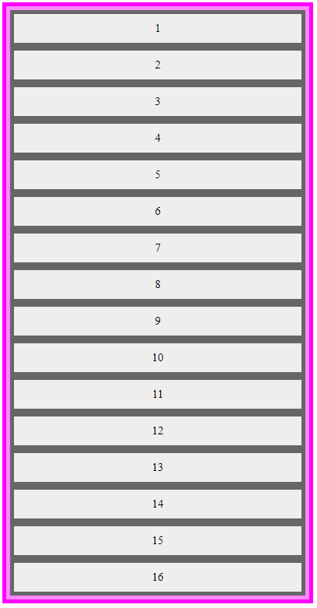
Grid on an applied science way [Setup]
[.html][.css]
*Hack and Slash* Article 4 till 14
13

Slide 14
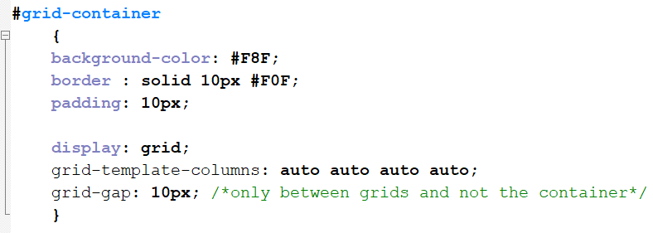
Grid on an applied science way [Setup]
[.css]
14

Slide 15
Grid on an applied science way [Setup]
[.css]
15

Slide 16
Grid on an applied science way [Setup]
[.css]
16

Slide 17
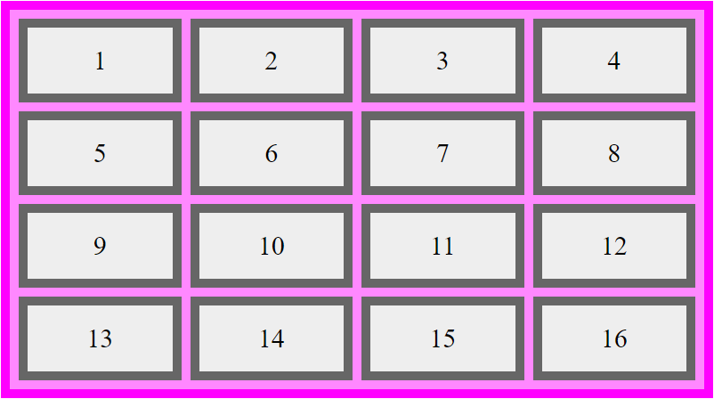
Grid on an applied science way [Setup]
[.css]
17

Slide 18
Grid on an applied science way [Setup]
[.css]
18

Slide 19
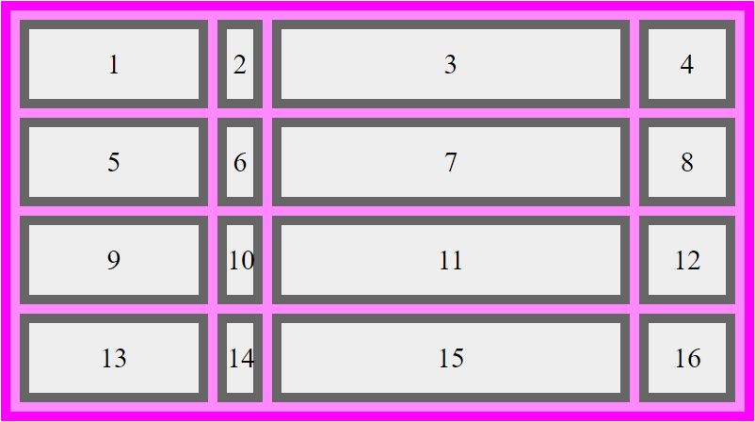
Grid on an applied science way [Setup]
[.css]
19

Slide 20
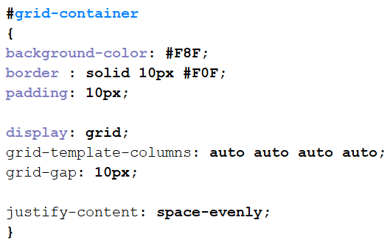
Grid on an applied science way [Setup]
[.css]
Back to
4x auto
20

Slide 21
Grid on an applied science way
[.css]
21

Slide 22
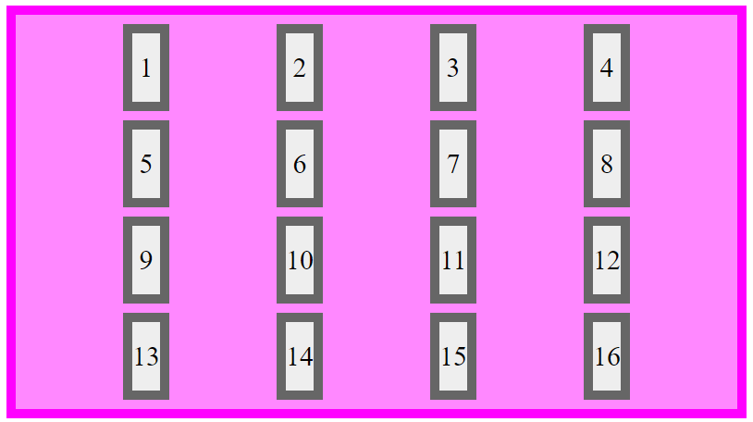
Grid on an applied science way
[.css]
22

Slide 23
Grid on an applied science way
[.css]
23

Slide 24
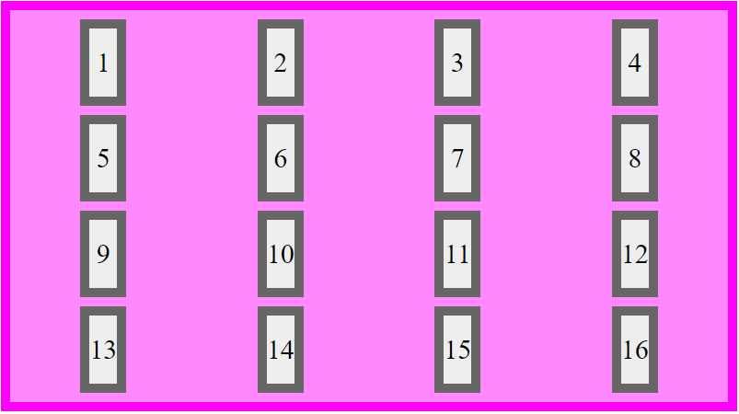
Grid on an applied science way
[.html]
24

Slide 25
Grid on an applied science way
[.css]
25

Slide 26
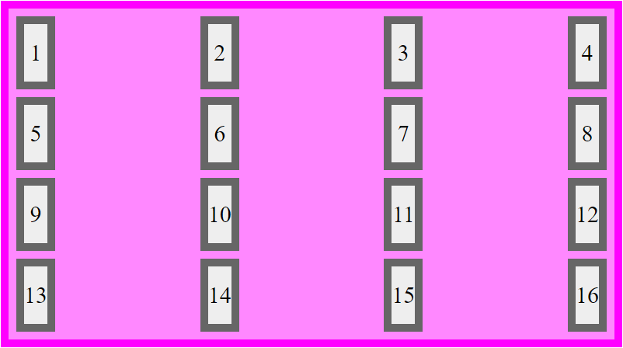
Grid on an applied science way
[.css]
26

Slide 27
Grid on an applied science way
[.css]
27

Slide 28
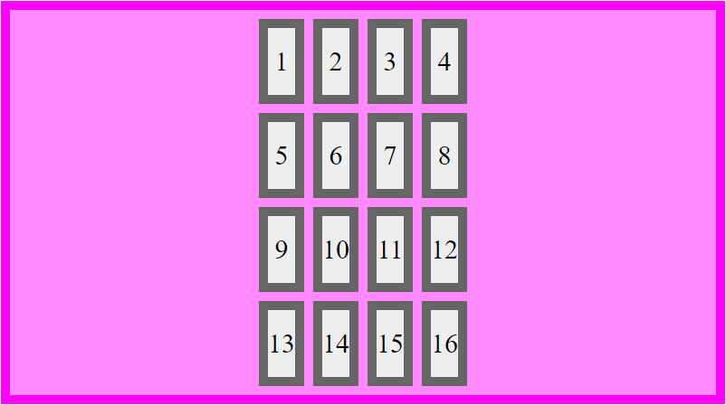
Grid on an applied science way
[.css]
28

Slide 29
Grid on an applied science way
[.css]
29

Slide 30

Grid on an applied science way
[.css]
30

Slide 31
Grid on an applied science way
Property value | justify-content | align-content
space-evenly | Horizontal space evenly (space divided by (objects in row +1)) | Vertical space evenly (space divided by (objects in a column +1))
space-around | Horizontal space around (space divided by (objects in row *2) | Vertical space around (space divided by (objects in a column *2)
space-between | Horizontal space between (space divided by (objects in row -1)) | Vertical space between (space divided by (objects in a column -1))
center | Horizontal centered (space divided 2) | Vertical centered (space divided 2)
start | All objects left (looks like float : left) (only one space on the end) | All objects top (only one space on the end)
end | All objects right (looks like float : right) (only one space on the start) | All objects bottom (only one space on the start)
31

Slide 32
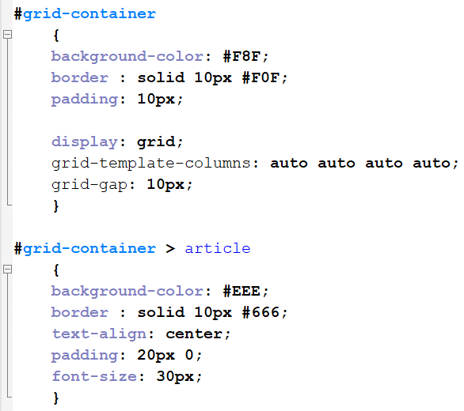
Grid on an applied science way
[.html][.css]
REMEMBER?
*Hack and Slash* Article 4 till 14
32

Slide 33
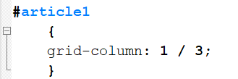
Grid on an applied science way
[.html][.css]
*Hack and Slash* Article 4 till 14
33

Slide 34
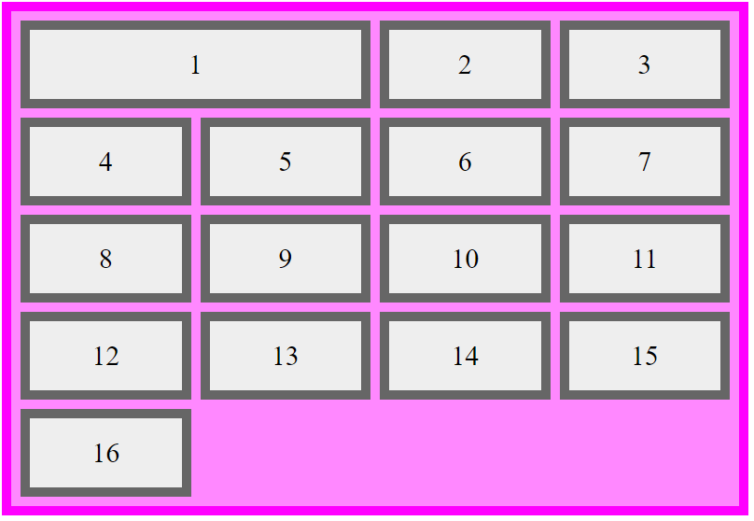
Grid on an applied science way
[.html][.css]
*Hack and Slash* Article 4 till 14
34

Slide 35
Grid on an applied science way
[.html][.css]
Start at column 1
and until column 3
*Hack and Slash* Article 4 till 14
35
Notes:
Start at column 1 and untill column 3.

Slide 36
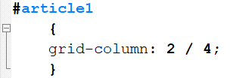
Grid on an applied science way
[.html][.css]
! BE AWARE
*Hack and Slash* Article 4 till 14
36

Slide 37
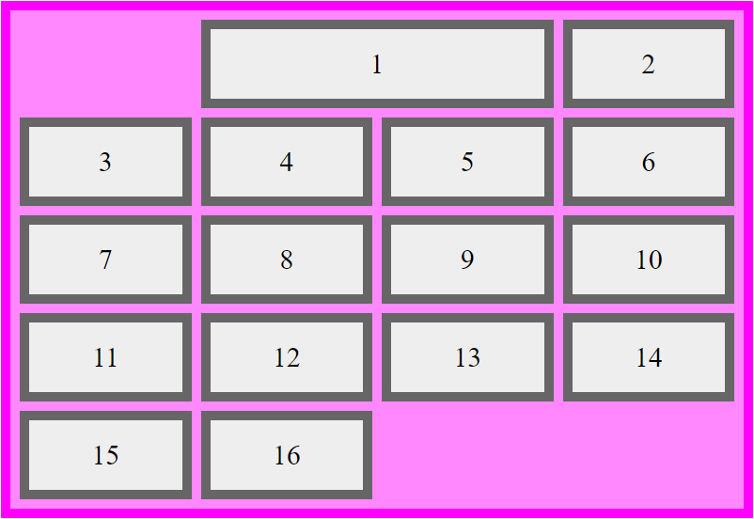
Grid on an applied science way
[.html][.css]
Start at column 2
and until column 3
*Hack and Slash* Article 4 till 14
37

Slide 38
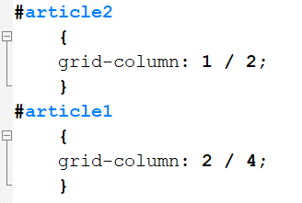
Grid on an applied science way
[.html][.css]
? Changing order ???
*Hack and Slash* Article 4 till 14
38

Slide 39
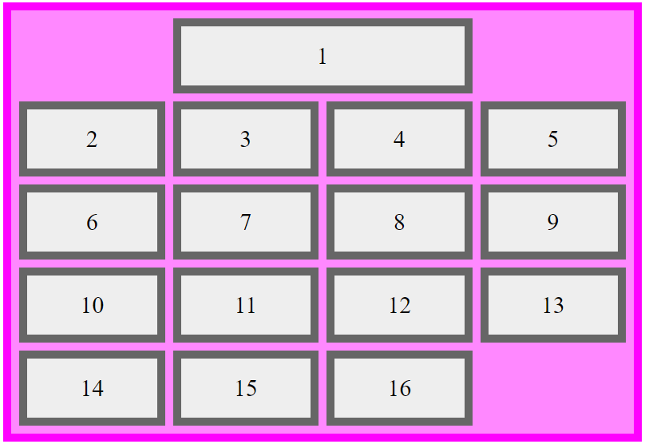
Grid on an applied science way
[.html][.css]
Nice try :P
But not working
*Hack and Slash* Article 4 till 14
39
Notes:
DO not worry , we supply a solution later !

Slide 40
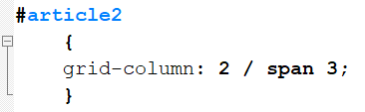
Grid on an applied science way
[.html][.css]
*Hack and Slash* Article 4 till 14
40

Slide 41
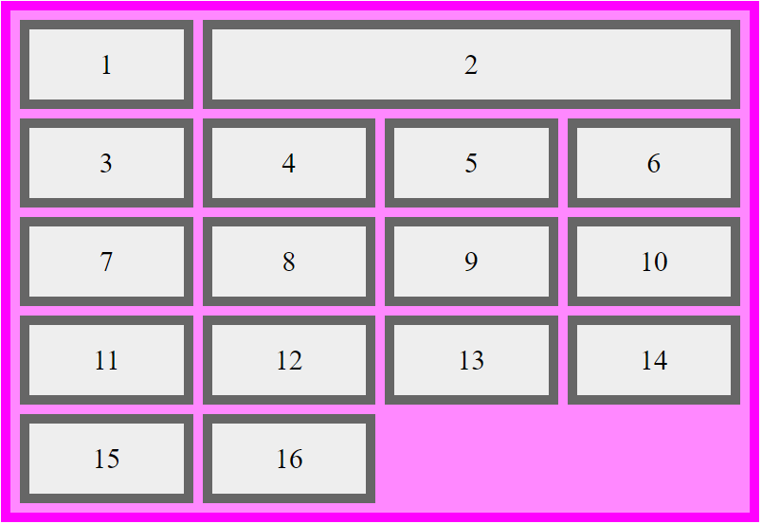
Grid on an applied science way
[.html][.css]
Start at column 2
and span 3 columns
*Hack and Slash* Article 4 till 14
41

Slide 42
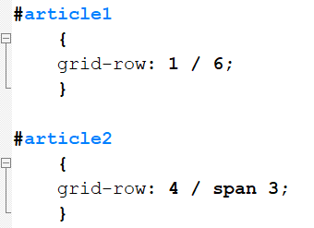
Grid on an applied science way
[.html][.css]
*Hack and Slash* Article 4 till 14
42

Slide 43
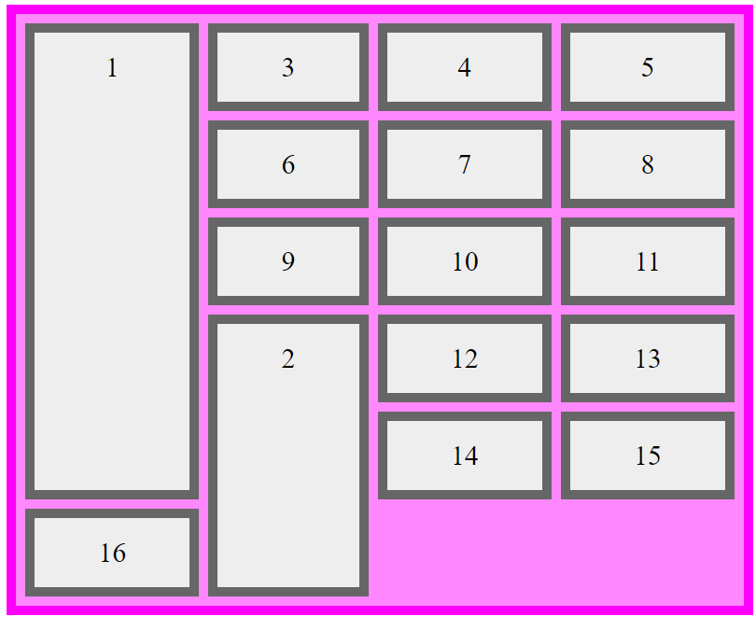
Grid on an applied science way
[.html][.css]
*Hack and Slash* Article 4 till 14
43

Slide 44
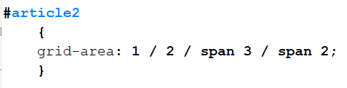
Grid on an applied science way
[.html][.css]
*Hack and Slash* Article 4 till 14
44

Slide 45
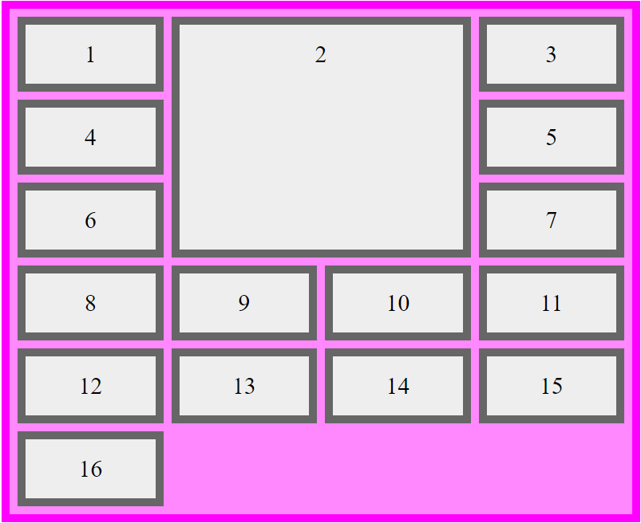
Grid on an applied science way
[.html][.css]
Start at
row 1 [y]
column 2 [x]
and span
3 rows [y]
2 columns [x]
*Hack and Slash* Article 4 till 14
45

Slide 46

Grid on an applied science way
INSANE ?
46

Slide 47
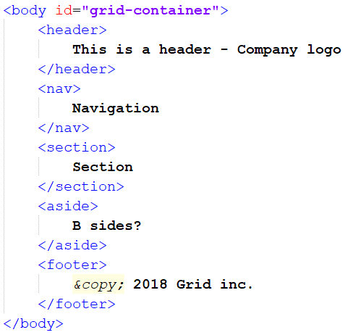
Grid on an applied science way
[.html]
47
Notes:
Now adding some meaningful HTML5 elements.

Slide 48
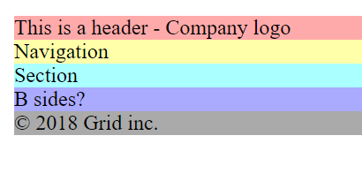
Grid on an applied science way
[.html]
Adding some colors
48
Notes:
Added some colors to see what is what

Slide 49
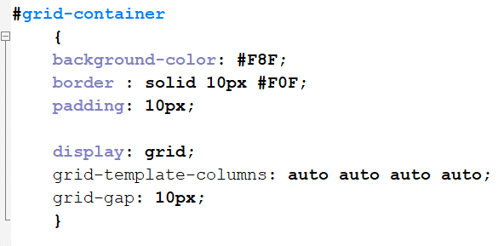
Grid on an applied science way
[.html][.css]
REMEMBER?
49
Notes:
This was the .css setup from last time

Slide 50

Grid on an applied science way
[.html][.css]
REMEMBER?
50
Notes:
Removing Grid template

Slide 51
Grid on an applied science way
GRID AREA
column 1 / row 1 | column 2 | column 3 | column 4 | column 5 | column 6
row 2
row 3
row 4
51
Notes:
Lets do it the GRID AREA way.

Slide 52
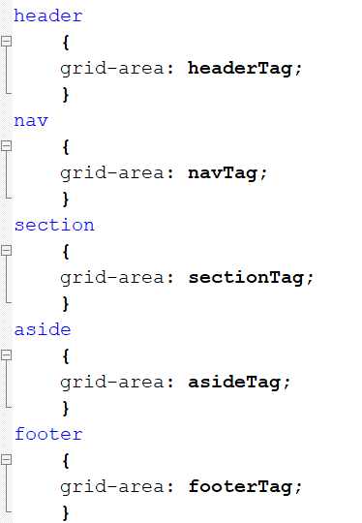
Grid on an applied science way
[.html][.css]
52
Notes:
Name the area’s

Slide 53
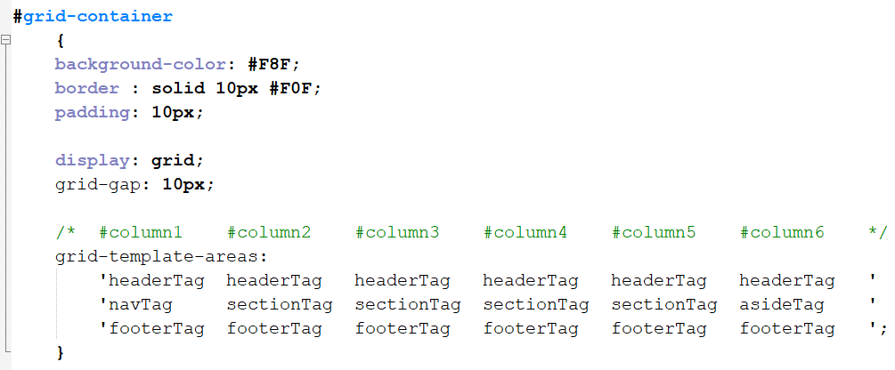
Grid on an applied science way
[.css]
53

Slide 54
Grid on an applied science way
[.css]
54

Slide 55

Grid on an applied science way
[.html]
55
Notes:
The result

Slide 56
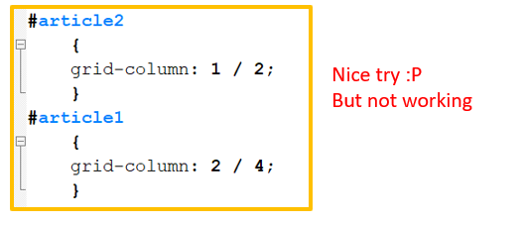
Grid on an applied science way
[.html][.css]
REMEMBER?
56

Slide 57
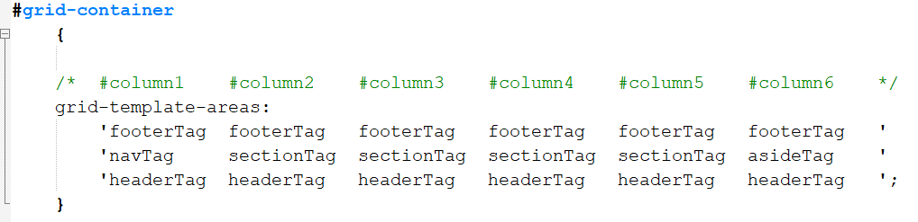
Grid on an applied science way
[.html][.css]
57

Slide 58
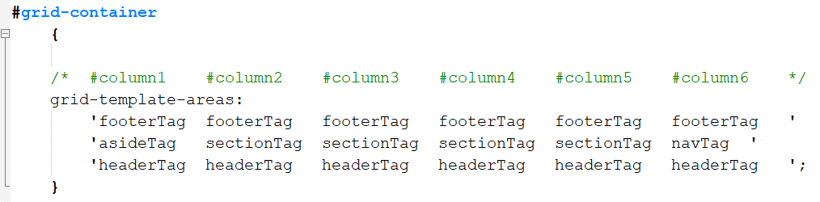
Grid on an applied science way
[.html][.css]
58

Slide 59
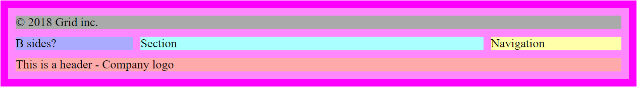
Grid on an applied science way
[.html][.css]
59
Notes:
Off course it is stupid to name HTML elements and not add classers and id for flexibilities.
We do it, because we can! Even if it is not smart ☺

Slide 60

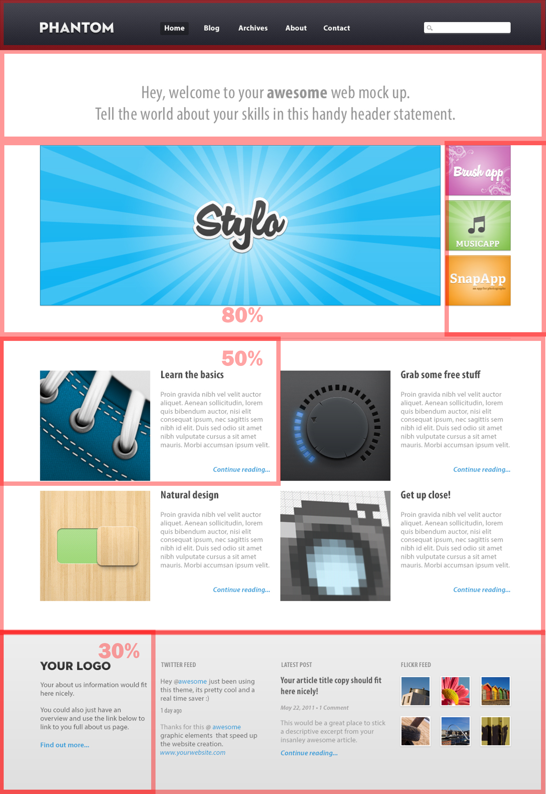
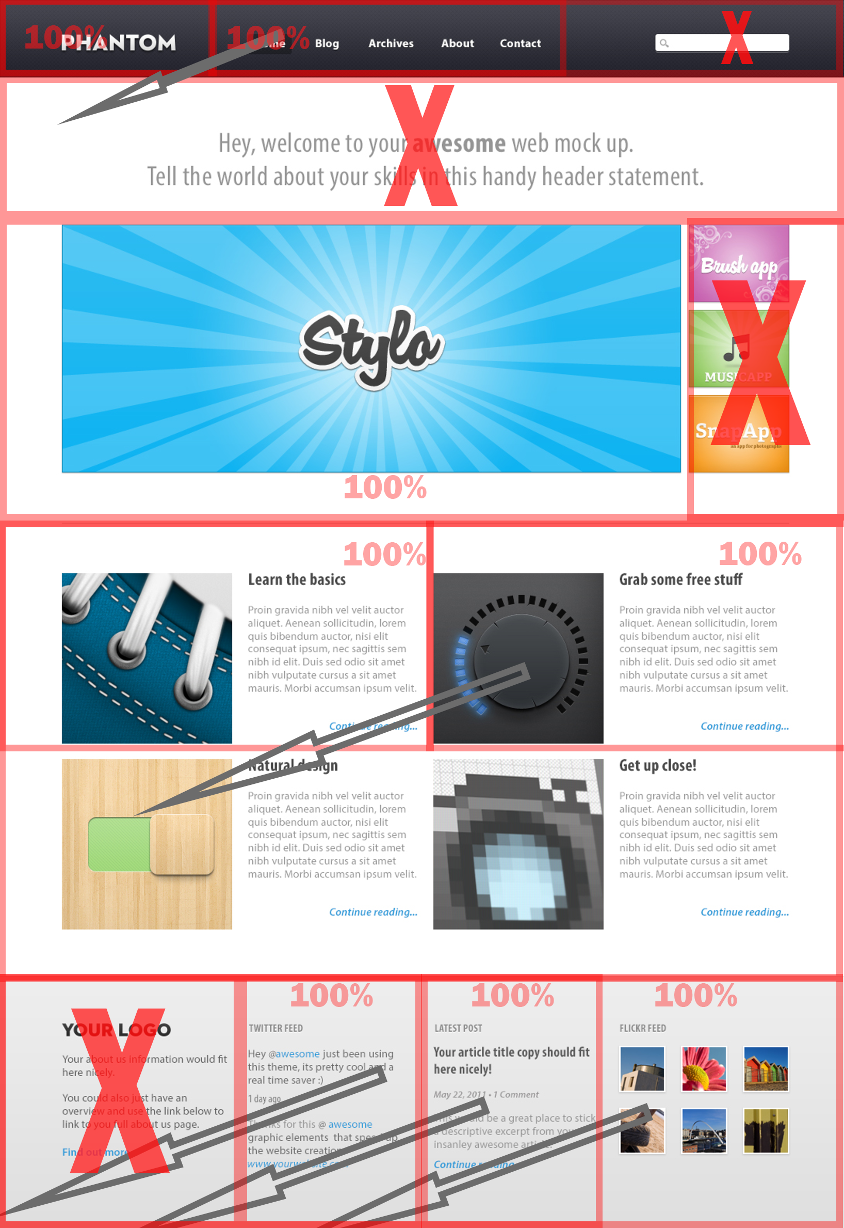
Assignment lecture 7.1
Create repository “Assignment72”.
Download the content from assignment 6.4
Develop a mobile (375px) and PC (1000px) with GRID and “comment” all flexbox code.
Commit your work to github.
Test your page online on PC and Mobile device.
30 min
60
60
Notes:
35-45 min

Slide 61

Bootstrap
61

Slide 62
Bootstrap
grid, flexbox & float ??
62
Notes:
Can we throw everything away?
NO WAY !!
(CC0) license pixels.com

Slide 63

Bootstrap
63
Notes:
In the future you can do everything you like.
Understand that it exist and it improve development time.
But for the assessment it is forbidden.
We like to know if the student can program and not copy paste.

Slide 64
Bootstrap
Front-end component library.
Framework; HTML , CCS and JavaScript
Open source.
64

Slide 65
Bootstrap
Front-end component library.
Framework; HTML , CCS and JavaScript
Open source.
65

Slide 66
Bootstrap
Front-end component library.
Framework; HTML , CCS and JavaScript
Open source.
66

Slide 67
Bootstrap
https://getbootstrap.com/
67

Slide 68
Bootstrap
Installation
Download
CDN
<link rel="stylesheet" href="https://url...
68

Slide 69
Bootstrap
Installation
Download
CDN
<link rel="stylesheet" href="https://url...
69

Slide 70

Bootstrap
Theme’s
70

Slide 71
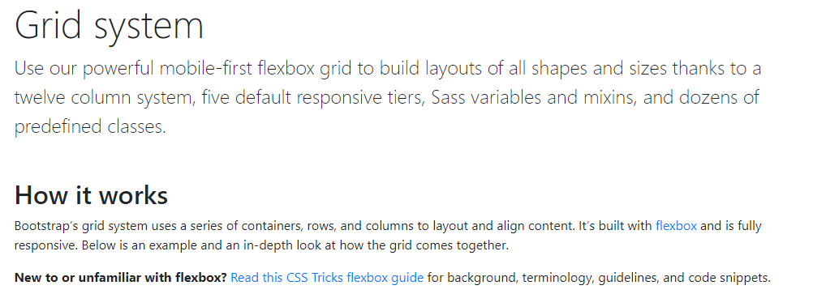
Bootstrap
Documentation
71

Slide 72
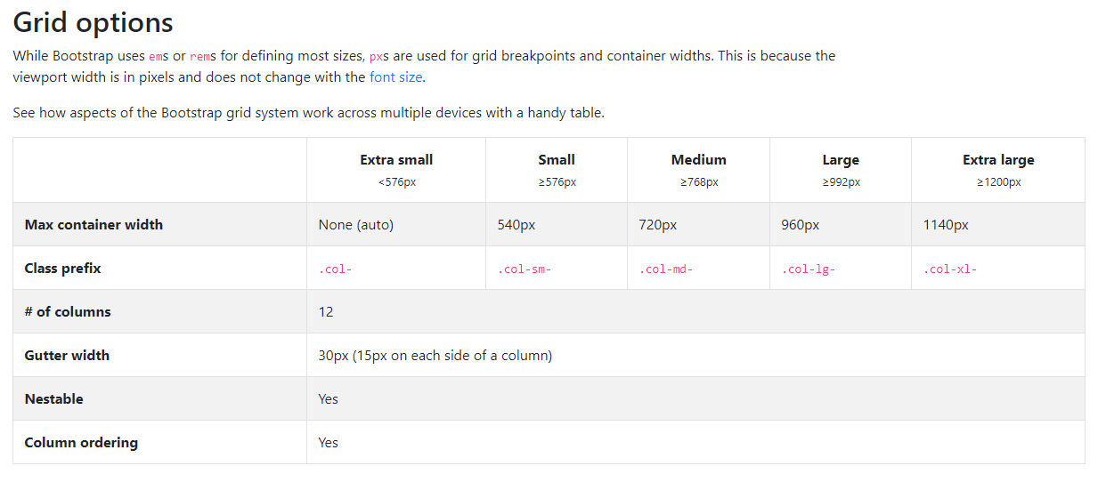
Bootstrap
Documentation
72

Slide 73
Bootstrap
Documentation
73

Slide 74
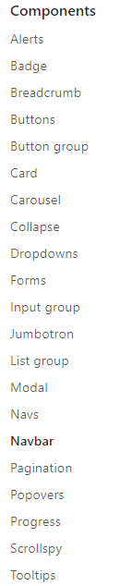
Bootstrap
74

Slide 75
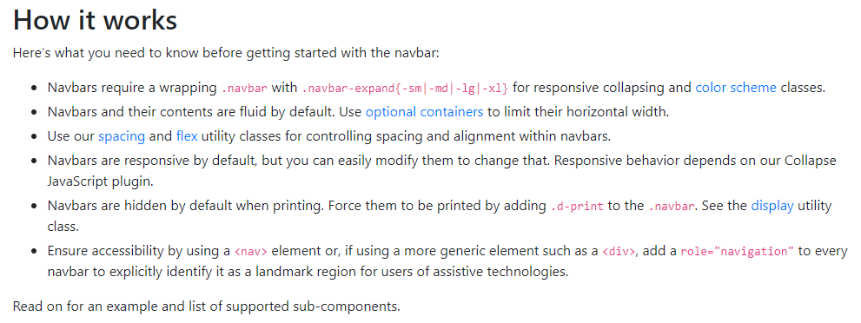
Bootstrap
75

Slide 76
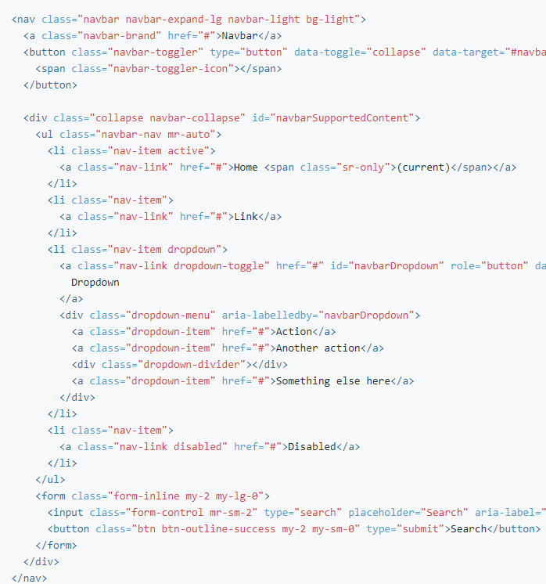
Bootstrap
76
Notes:
Even if you look to the examples … You need to invest a lot of time to figure out how it is really working.

Slide 77
Flexbox vs Grid
FLEXBOX
VS
GRID
77

Slide 78
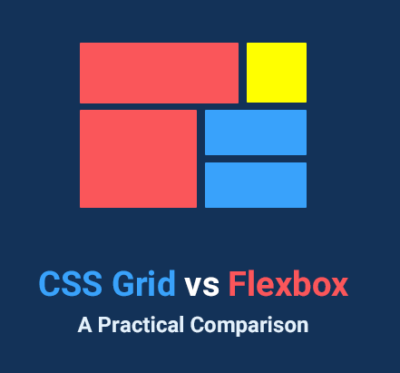
Assignment lecture 7.2
Create repository “Assignment72”.
Download the content
https://tutorialzine.com/2017/03/css-grid-vs-flexbox
Follow the tutorial
Commit your work to github.
30 min
78
78
Notes:
Great site to visit to understand the difference. We do not have time to go deeper in the lesson.
70 – 90 min

Slide 79
Flexbox vs Grid
Use Grid unless Grid can not do it. (wider acceptance)
Flexbox does offer better rules for spacing between items on a row
Use flexbox for all linear (1D -> width) web development (most common)
Use grid for all positioning (2D -> width and height) web development
79

Slide 80
Flexbox vs Grid
Use Grid unless Grid can not do it. (wider acceptance)
Flexbox does offer better rules for spacing between items on a row
Use flexbox for all linear (1D -> width) web development (most common)
Use grid for all positioning (2D -> width and height) web development
80

Slide 81
Flexbox vs Grid
Use Grid unless Grid can not do it. (wider acceptance)
Flexbox does offer better rules for spacing between items on a row
Use flexbox for all linear (1D -> width) web development (most common)
Use grid for all positioning (2D -> width and height) web development
Header
Article 1 | Article 2
Article 3 | Article 4 | Aside
Footer
81

Slide 82
Flexbox vs Grid
Use Grid unless Grid can not do it. (wider acceptance)
Flexbox does offer better rules for spacing between items on a row
Use flexbox for all linear (1D -> width) web development (most common)
Use grid for all positioning (2D -> width and height) web development
Header
Article 1 | Article 3 | Aside | NAV
Article 3
 |  |  | Aside
Footer
82

Slide 83
Bootstrap vs Grid
Bootstrap
VS
GRID
83

Slide 84
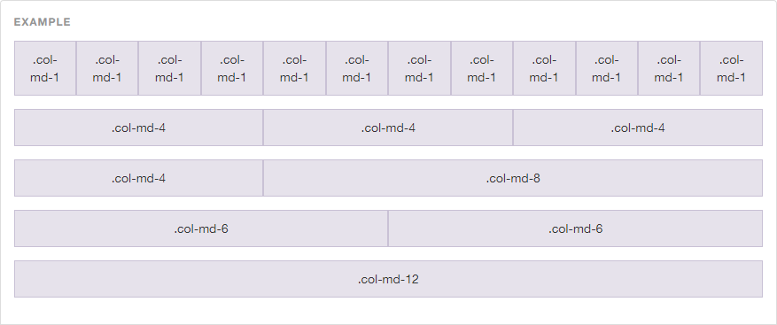
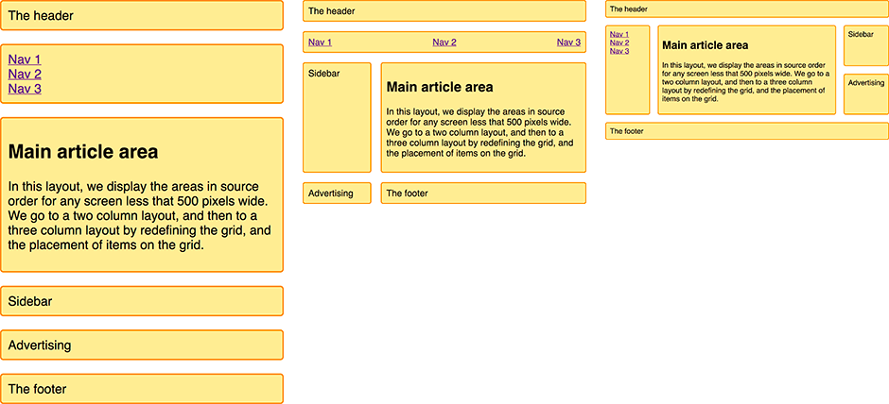
Bootstrap vs Grid
Markup is simpler
84

Slide 85

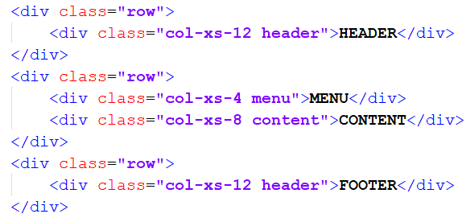
Bootstrap vs Grid
[.html]
Div!
Bootstrap
85
Notes:
We could have used semantic elements here, but We are choosing to stick with div’s to make the comparison to the Bootstrap example easier.

Slide 86
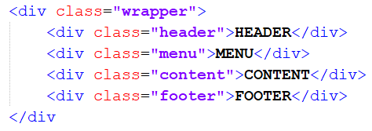
Bootstrap vs Grid
[.html]
Div!
Div!
Bootstrap
GRID
86
Notes:
We could have used semantic elements here, but We are choosing to stick with div’s to make the comparison to the Bootstrap example easier.

Slide 87
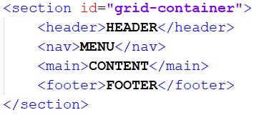
Bootstrap vs Grid
[.html]
Div!
Can also talk semantic
Bootstrap
GRID
87
Notes:
We could have used semantic elements here, but We are choosing to stick with div’s to make the comparison to the Bootstrap example easier.

Slide 88
Bootstrap vs Grid
[.html]
Responsive
Bootstrap
88
Notes:
Even worse with responsive website!!!

Slide 89

Bootstrap vs Grid
89
Notes:
Reordering the content

Slide 90
Bootstrap vs Grid
[.html]
Bootstrap
GRID
90
Notes:
Bootstrap -> move HTML code

Slide 91
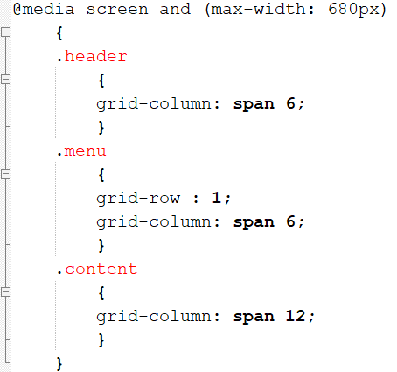
Bootstrap vs Grid
[.html][.css]
Bootstrap
GRID
91
Notes:
Bootstrap -> move HTML code

Slide 92
Conclusion
Use Grid unless Grid can not do it. (wider acceptance)
Flexbox does offer better rules for spacing between items on a row
Use flexbox for all linear (1D -> width) web development (most common)
Use grid for all positioning (2D -> width and height) web development
REMEMBER?
92

Slide 93

Assessment in big lines
93

Slide 94

Resume lecture
Grid
Grid vs frameworks
Bootstrap
Foundation
Project explaining
Project support
94

Slide 95

Questions
95
Notes:
(CC0) license

